Slide 1
SECURE DATA HIDING IN IMAGES USING STEGANOGRAPHY
CAPSTONE PROJECT
Presented By:
Student Name : Kunisetty Nikhita Siri Vasavi Pallavi
College Name & Department : KKR and KSR Institute of Technology and Sciences & Computer Artificial Intelligence

Slide 2

OUTLINE
Problem Statement
Technology used
Wow factor
End users
Result
Conclusion
Git-hub Link
Future scope

Slide 3
Problem Statement
The main problem of sharing data between the users is interference of the unauthorized users or parties.
Main aim of the communication over a network is that the data that is shared between the users must be secured and safely transferred.
The challenge lies in ensuring the security, integrity, and confidentiality of the hidden data while maintaining the quality of the image.
So through our project we design a Steganography Algorithm that allows safe and secured data sharing.

Slide 4
Technology used
Libraries:
Python Libraries:
OpenCV : For image manipulation and processing.
Pillow (PIL) : For working with image files and formats.
NumPy : For handling data in arrays, especially for pixel manipulation.
Cryptography: For encrypting the data before embedding it within the image for added security.
Platforms:
Programming Languages:
Python : Widely used for image processing and implementing steganography algorithms.
Development Platforms:
Jupyter Notebook : For experimentation and visualizing data processing steps.
VS Code : IDEs for coding and debugging the project.
Anaconda : For managing dependencies and environments in Python.
Operating System :
Windows/Linux/Mac: Any platform that supports Python and the necessary libraries.

Slide 5
Wow factors
Enhanced Security: Utilizes encryption methods alongside steganography to ensure data is securely hidden within images.
Robust Algorithms: Implements advanced algorithms to prevent detection and ensure data integrity during transmission.
Improved Payload Capacity: Maximizes the amount of data that can be hidden without compromising image quality.
User-Friendly Interface: Provides an intuitive platform for non-technical users to securely embed and extract data from images.
Multi-Platform Compatibility: Ensures the technique works across different devices and software environments seamlessly.

Slide 6
End users
Businesses and Corporations: To protect intellectual property, trade secrets, or confidential business information when sharing files or images.
Cybersecurity Professionals: To develop secure communication channels and protect sensitive data from cyber threats and interception.
Journalists and Activists: To safely transmit sensitive information and protect their sources in areas with strict censorship or surveillance.
Private Individuals: For personal use, such as protecting sensitive data, private conversations, or images from unauthorized access while ensuring data privacy.
Researchers and Developers: Working on cryptography, digital forensics, and data protection can use the steganography techniques for testing and creating innovative security solutions.

Slide 7
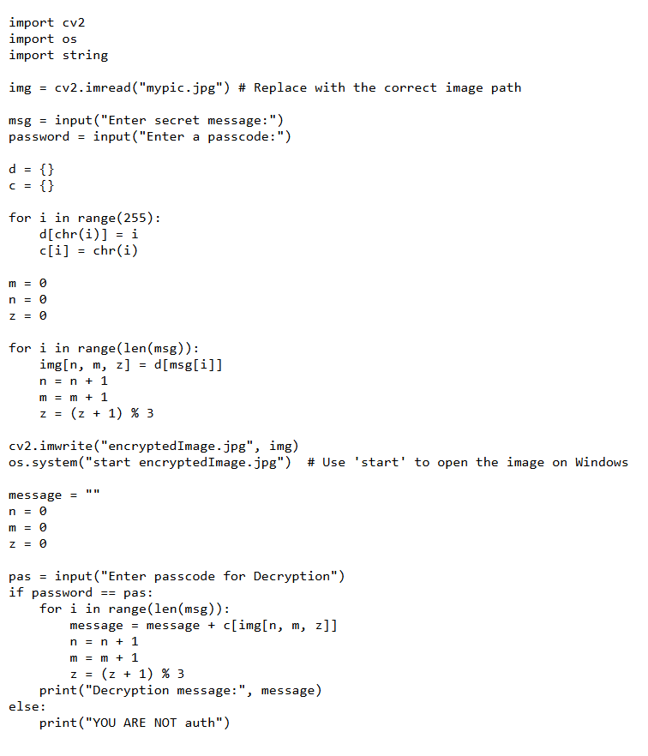
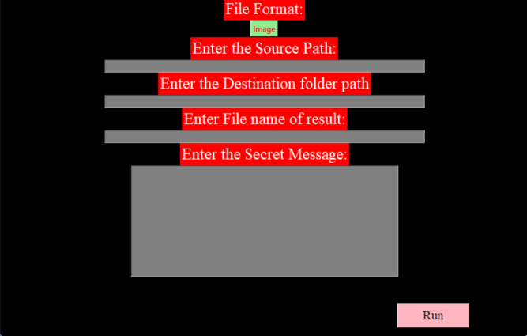
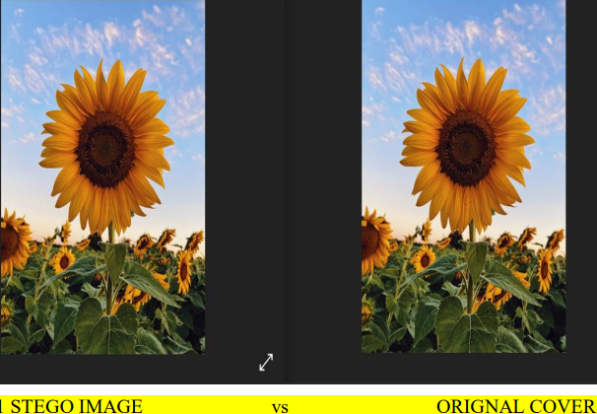
Results

Slide 8
Conclusion
Image steganography is a perfect solution for the information leaks and data insecurity. Image steganography allows secretly passing on the information between the users and the alterations and the other changes are not visible. It allows lossless compression of the cover image. The size, the quality of the original cover image and the secret text embedded image (stego image) remains unchanged. There are the alterations in the pixels but not visible to the human eye. That is the biggest reason that this technique is one of the best techniques used in the information security for the data hiding and secured communication.

Slide 9
GitHub Link
https://github.com/nikhitapallavi/MY-PROJECT-STEGO.git

Slide 10
Future scope(optional)
Integration with Blockchain: Implementing blockchain technology for verifying the authenticity of the hidden data, enhancing data integrity and traceability.
Real-Time Applications: Developing real-time steganographic systems for secure communication in fields like military, banking, and online privacy.
AI-Based Detection Prevention: Using AI to dynamically adapt hiding techniques to avoid detection by increasingly sophisticated image analysis algorithms.
Enhanced Data Capacity: Researching methods to increase the amount of data that can be hidden without affecting the quality of the image or raising suspicion.
Cross-Media Steganography: Expanding the technique to hide data within videos, audio files, or even 3D models, making it adaptable across different media formats
6.Mobile & IoT Security: Integrating secure steganographic techniques into mobile apps and IoT devices for safeguarding communication in resource-constrained environment.

Slide 11
THANK YOU

